Slide 1
Learning From Observations

Slide 2
Outline
Learning agents
Inductive learning
Decision tree learning

Slide 3
Learning
Learning is essential for unknown environments,
i.e., when designer lacks omniscience
Learning is useful as a system construction method,
i.e., expose the agent to reality rather than trying to write it down
Learning modifies the agent's decision mechanisms to improve performance

Slide 4
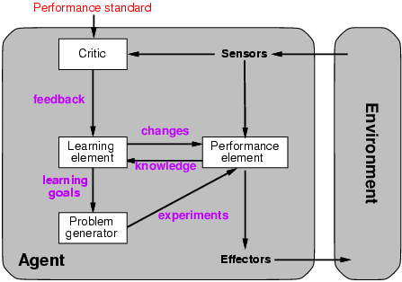
Learning agents

Slide 5
Learning element
Design of a learning element is affected by
Which components of the performance element are to be learned
What feedback is available to learn these components
What representation is used for the components
Type of feedback:
Supervised learning: correct answers for each example
Unsupervised learning: correct answers not given
Reinforcement learning: occasional rewards

Slide 6
AI 是一門最悲劇的學科
每當它的一個子領域發展得像模像樣之後，就馬上自立門戶，從此和 AI “再無瓜葛”了，而 Machine Learning 大概要算是最新的一個典型吧。
一開始的時候，大牛們都野心勃勃，而且好像也是信心滿滿，大家可能覺得，不出幾十年，人類就可以不用思考，交給 AI 來做了。幾十年後，發現情況並不像當年那麼樂觀，卻又有些下不了臺了。這個時候，AI 的一些旁枝或者子領域果斷放下面子，丟掉了那個近乎玄幻的目標，逐漸發展成為“正常”的學科，所以也就不再好稱為 AI 了。或者說現在的 AI 有兩個意思，一個廣義的 AI ，包括了所有相關的以及派生的領域，另一個則是狹義的或者經典的 AI ，專門指那些仍然在執著地追求著真正的“智慧”的部分，或者說得不好聽一點，就是剩下的部分。

Slide 7
Machine Learning 是什麽？
對於我們需要分析或者處理的資料，根據一些經驗和一些假設，我們可以構建一個模型，這個模型會有一些參數（即使是非參數化方法，也是可以類似地看待的），根據資料來求解模型參數的過程，就叫做 Parameter Estimation ，或者 Model Fitting ，但是搞機器學習的人，通常把它叫做 Learning （或者，換一個角度，叫 Training）——因為根據資料歸納出一個有用的模型，這和我們人類“學習”的過程還是挺類似的。

Slide 8
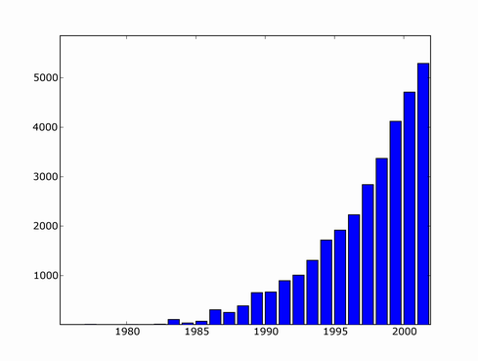
Machine Learning Articles by Year
Machine learning is a burgeoning field. Attendance has increased more than 50% during the last four years at the Neural Information Processing Systems (NIPS) conference, one of the premier conferences for machine learning research.
The field is progressing rapidly, and an air of excitement among researchers is being created by the increasing scope of applications to which machine learning is relevant, and by the many technical advances that have been made in recent years.
It is also an increasingly popular area for young people entering the field of computer science. Among the applicants to Carnegie Mellon’s Computer Science Ph.D. program in 2005, 22% indicated an interest in machine learning; 103 candidates applied this year to Carnegie Mellon’s new Ph.D. Program in Computational and Statistical Learning.

Slide 9
Why is ML so popular?
Modern societies have entered the “data era”—an unprecedented (空前的) investment is being made in the collection of data, with archives being formed on an enormous scale.
The development of effective ways of extracting useful information from these data stores is an overall challenge to computer science as a discipline, with the goal of providing a greater return on the huge investment that is being made in data. This goal drives much of machine learning research.
Flipside: PRIVACY

Slide 10
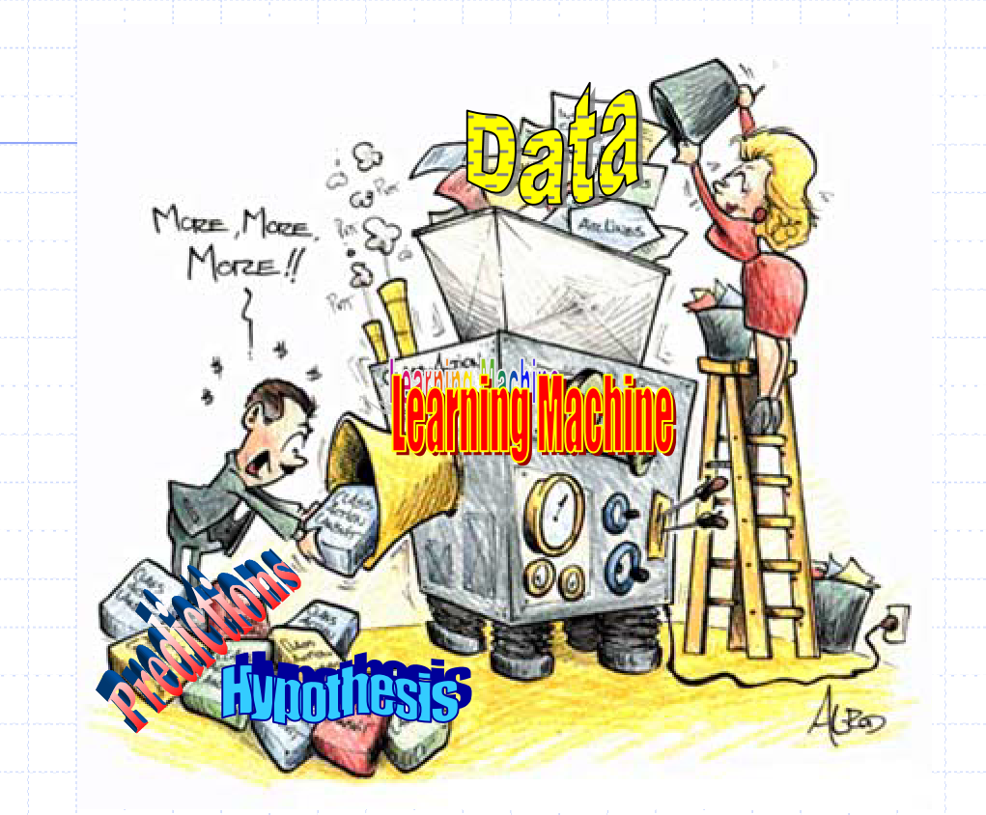

Slide 11
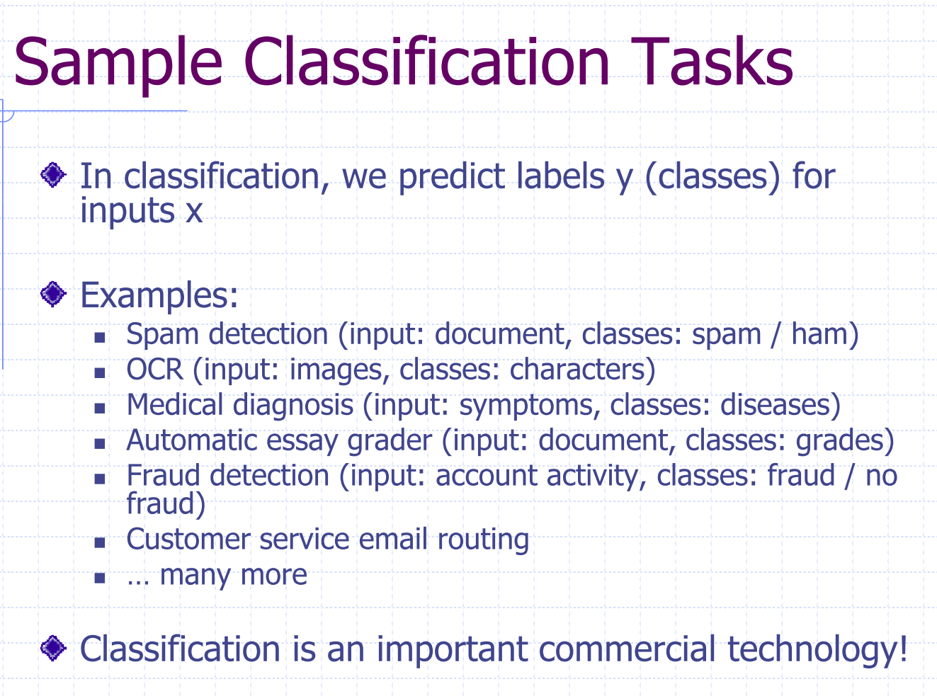

Slide 12
Inductive learning
Simplest form: learn a function from examples
f is the target function
An example is a pair (x, f(x))
Problem: find a hypothesis h
such that h ≈ f
given a training set of examples
This is a highly simplified model of real learning:
Ignores prior knowledge
Assumes examples are given

Slide 13
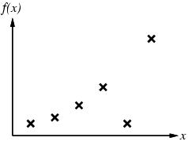
Inductive learning method
Construct/adjust h to agree with f on training set
(h is consistent if it agrees with f on all examples)
E.g., curve fitting:

Slide 14
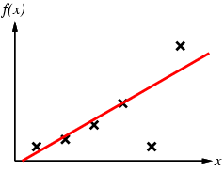
Inductive learning method
Construct/adjust h to agree with f on training set
(h is consistent if it agrees with f on all examples)
E.g., curve fitting:

Slide 15
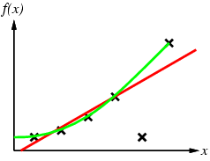
Inductive learning method
Construct/adjust h to agree with f on training set
(h is consistent if it agrees with f on all examples)
E.g., curve fitting:

Slide 16
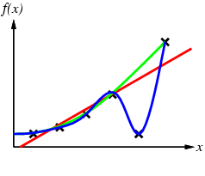
Inductive learning method
Construct/adjust h to agree with f on training set
(h is consistent if it agrees with f on all examples)
E.g., curve fitting:

Slide 17
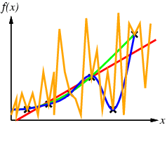
Inductive learning method
Construct/adjust h to agree with f on training set
(h is consistent if it agrees with f on all examples)
E.g., curve fitting:

Slide 18
Inductive learning method
Construct/adjust h to agree with f on training set
(h is consistent if it agrees with f on all examples)
E.g., curve fitting:
Ockham’s razor: prefer the simplest hypothesis consistent with data

Slide 19
Learning decision trees
Problem: decide whether to wait for a table at a restaurant, based on the following attributes:
Alternate: is there an alternative restaurant nearby?
Bar: is there a comfortable bar area to wait in?
Fri/Sat: is today Friday or Saturday?
Hungry: are we hungry?
Patrons(顧客): number of people in the restaurant (None, Some, Full)
Price: price range ($, $$, $$$)
Raining: is it raining outside?
Reservation: have we made a reservation?
Type: kind of restaurant (French, Italian, Thai, Burger)
WaitEstimate: estimated waiting time (0-10, 10-30, 30-60, >60)

Slide 20
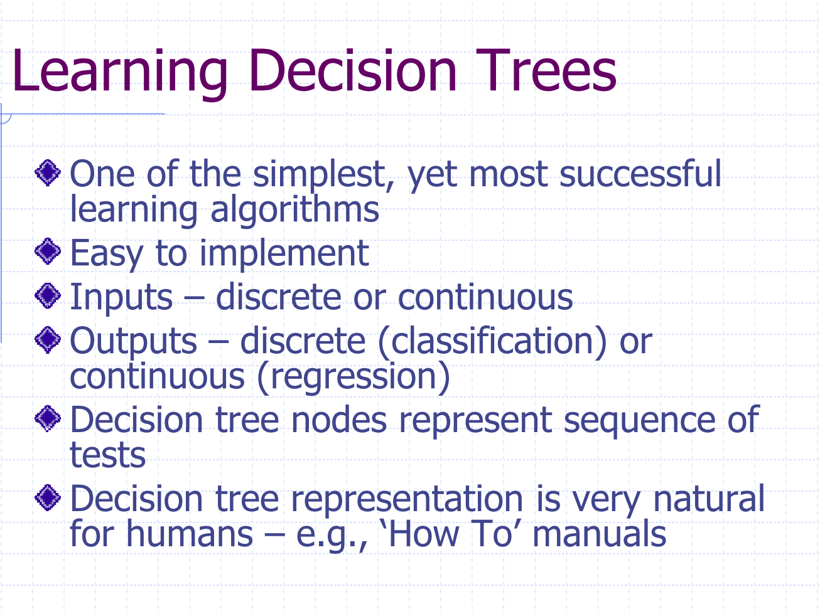

Slide 21
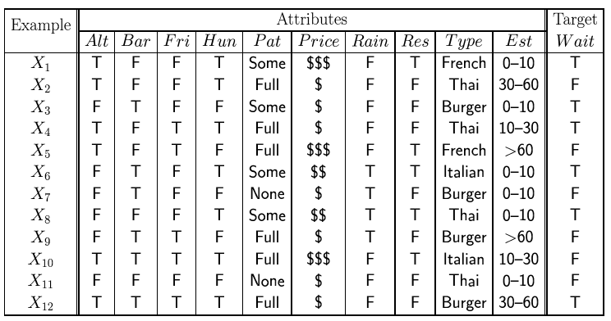
Attribute-based representations
Examples described by attribute values (Boolean, discrete, continuous)
E.g., situations where I will/won't wait for a table:
Classification of examples is positive (T) or negative (F)

Slide 22
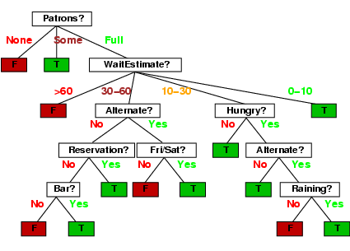
Decision trees
One possible representation for hypotheses
E.g., here is the “true” tree for deciding whether to wait:

Slide 23
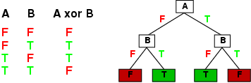
Expressiveness
Decision trees can express any function of the input attributes.
E.g., for Boolean functions, truth table row → path to leaf:
Trivially, there is a consistent decision tree for any training set with one path to leaf for each example (unless f nondeterministic in x) but it probably won't generalize to new examples
Prefer to find more compact decision trees

Slide 24
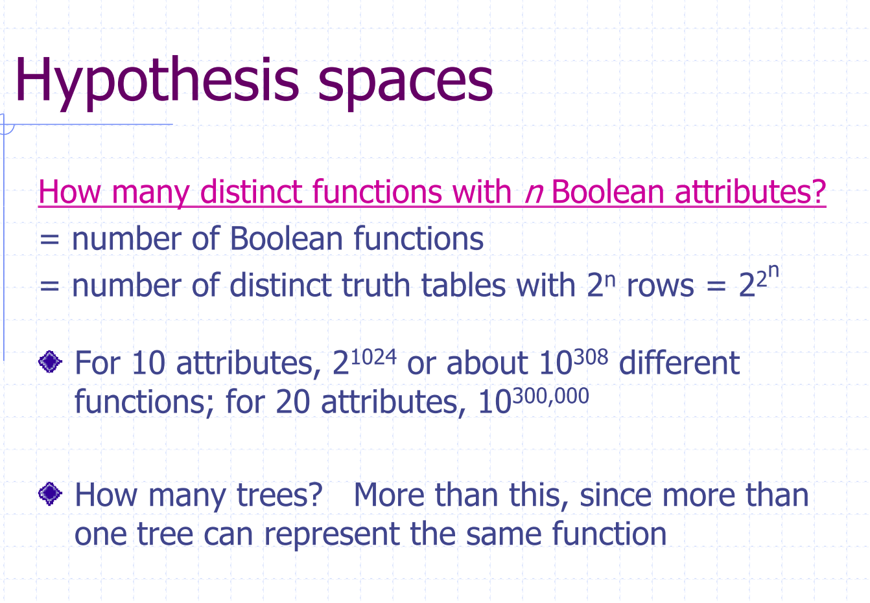

Slide 25
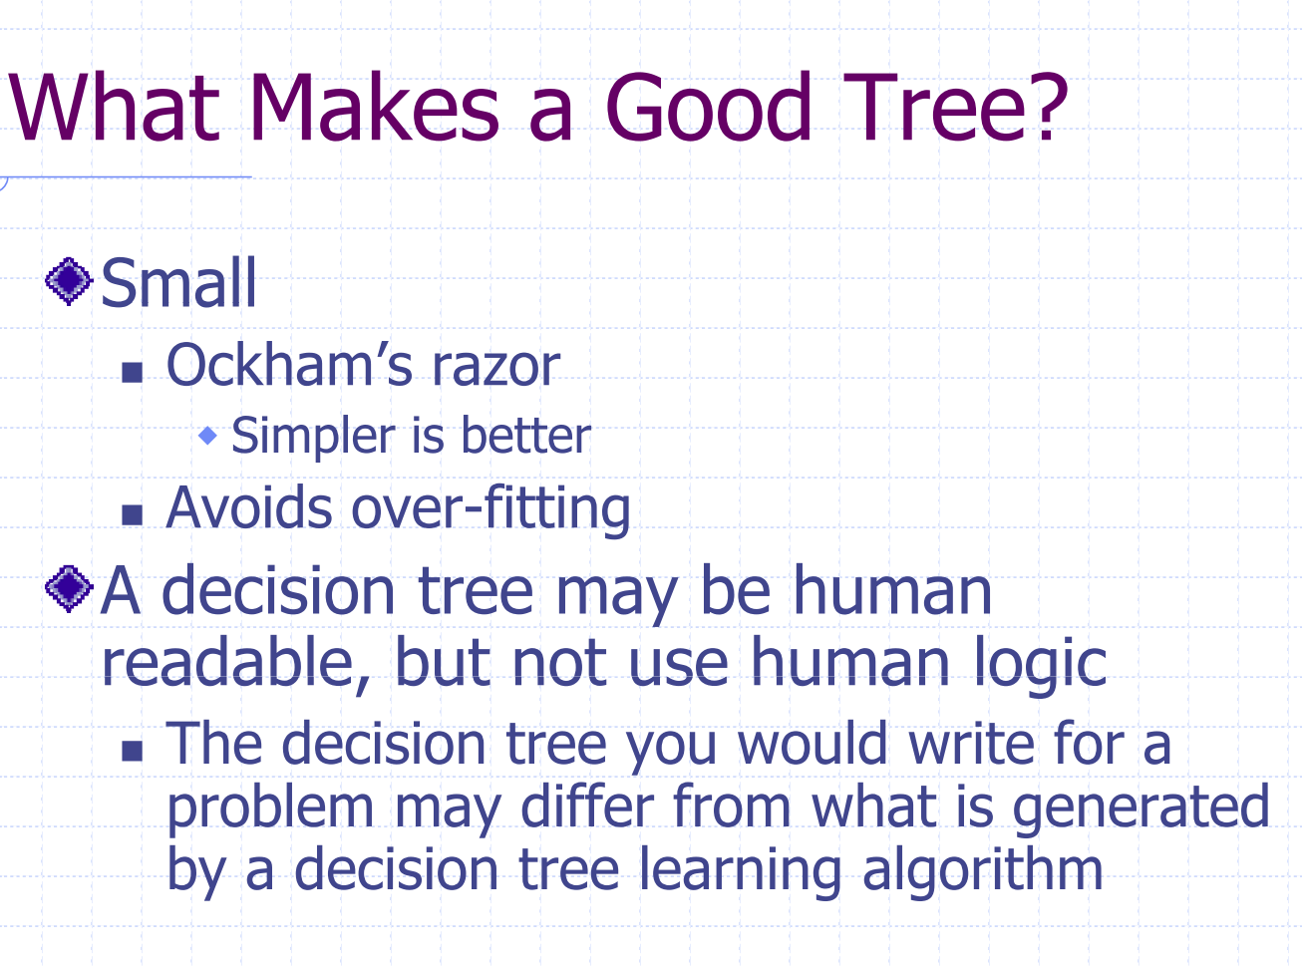

Slide 26
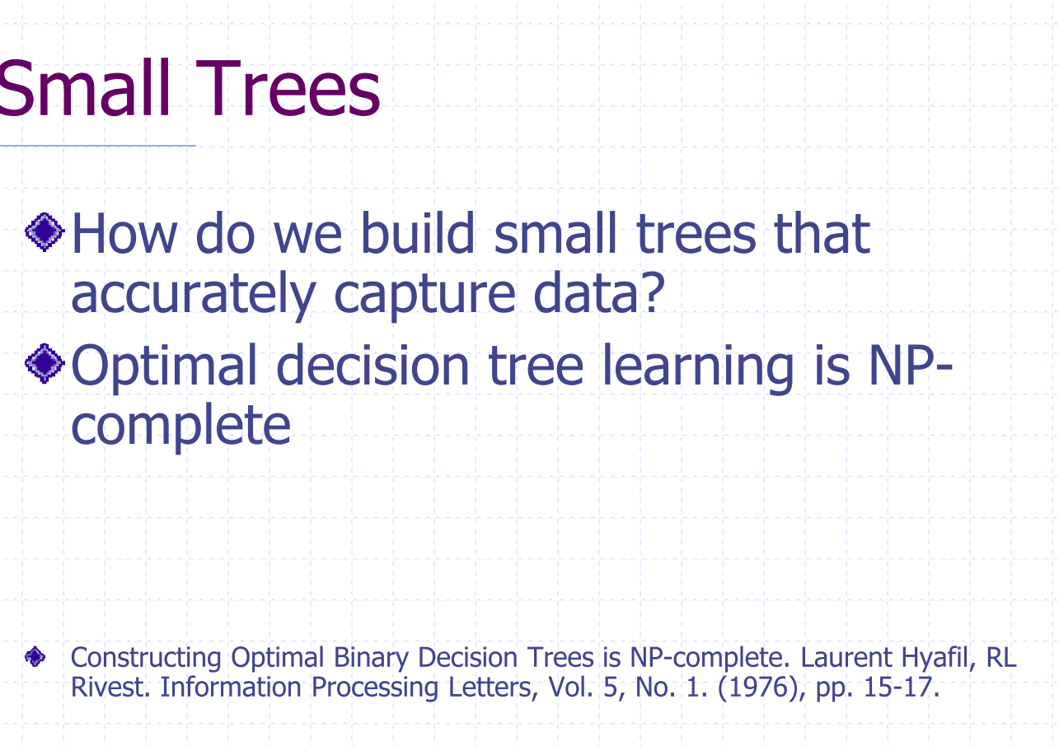

Slide 27
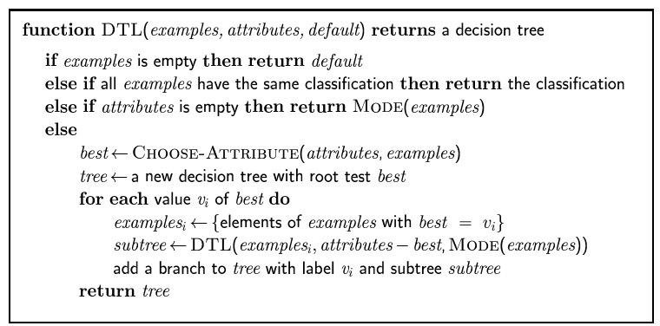
Decision tree learning
Aim: find a small tree consistent with the training examples
Idea: (recursively) choose "most significant" attribute as root of (sub)tree

Slide 28
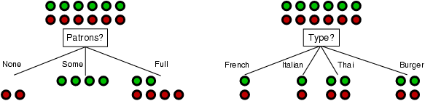
Choosing an attribute
Idea: a good attribute splits the examples into subsets that are (ideally) "all positive" or "all negative"
Patrons? is a better choice

Slide 29
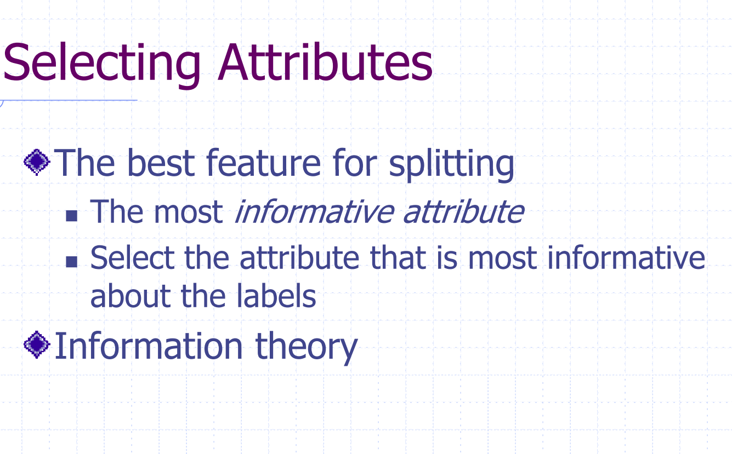

Slide 30
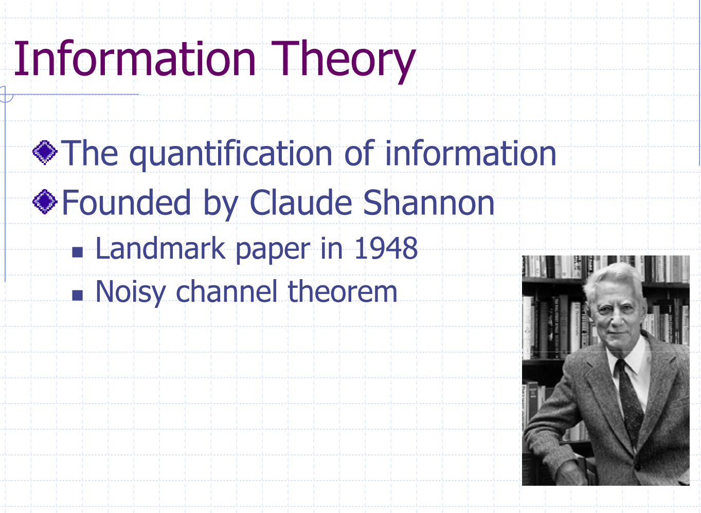

Slide 31
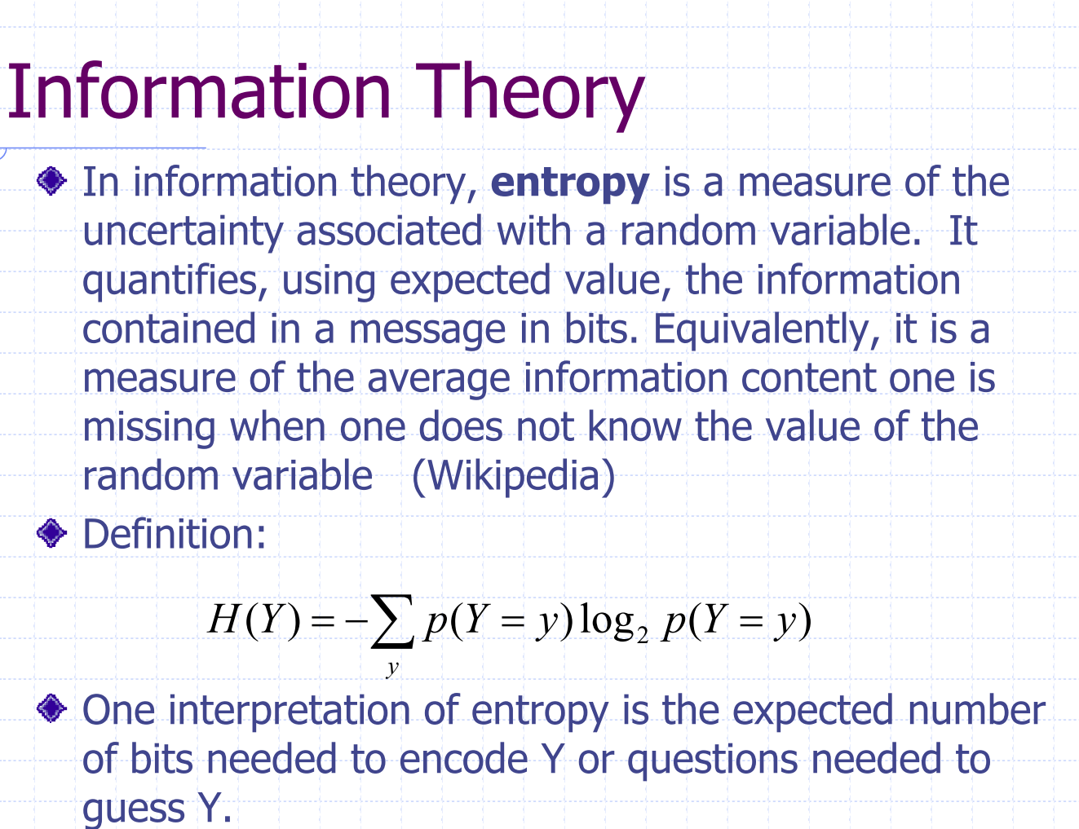

Slide 32
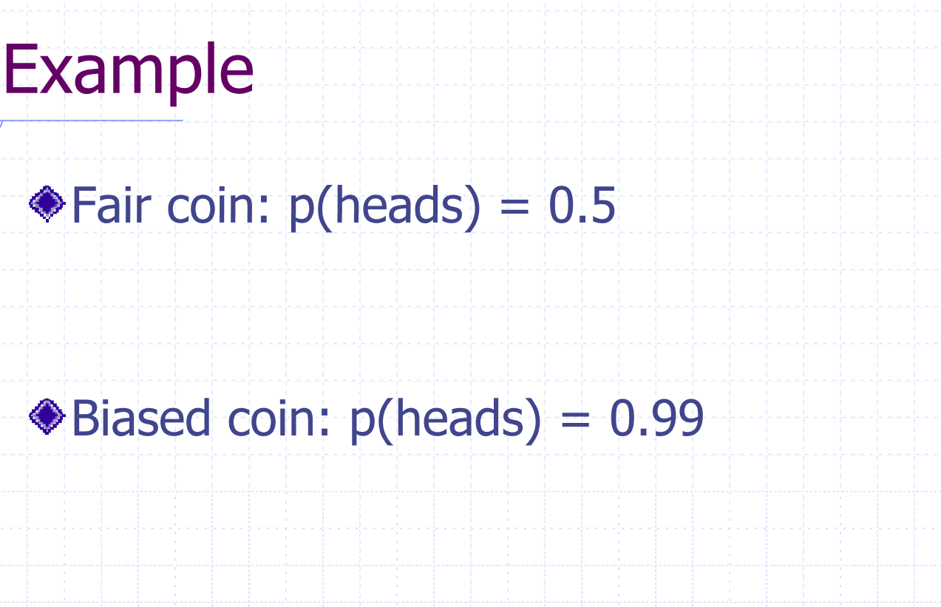

Slide 33
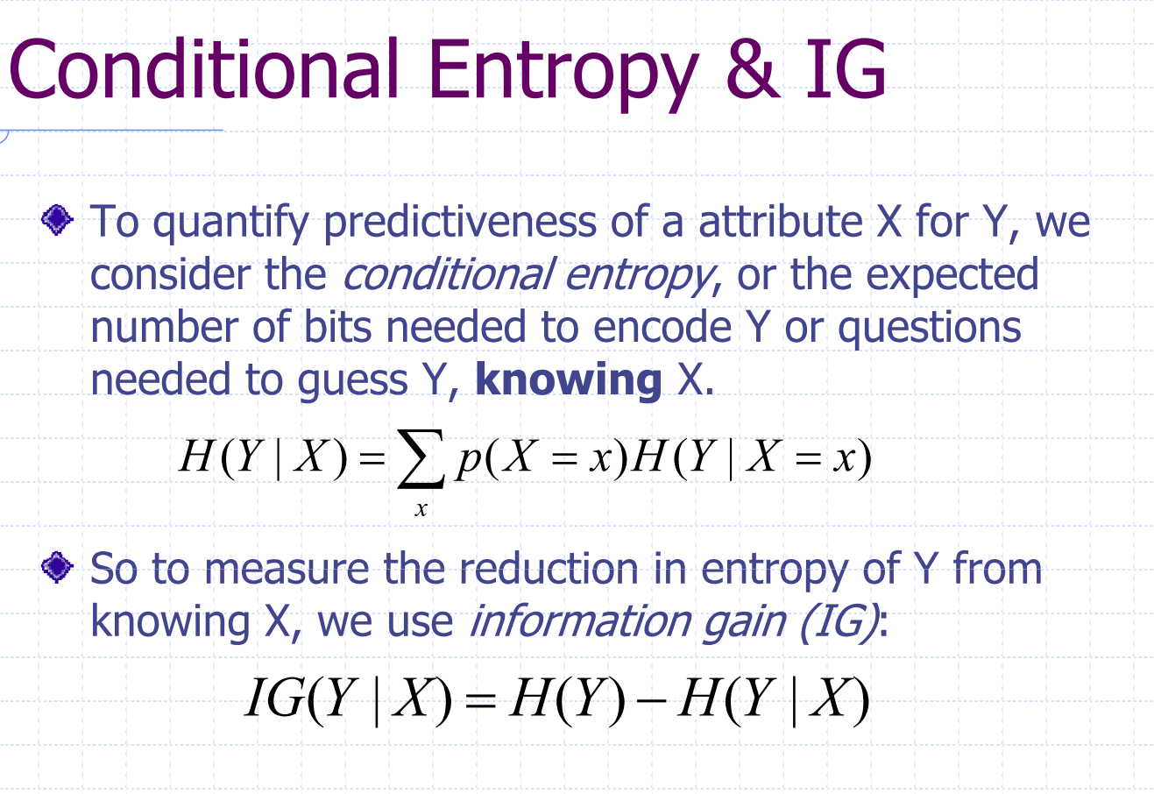

Slide 34
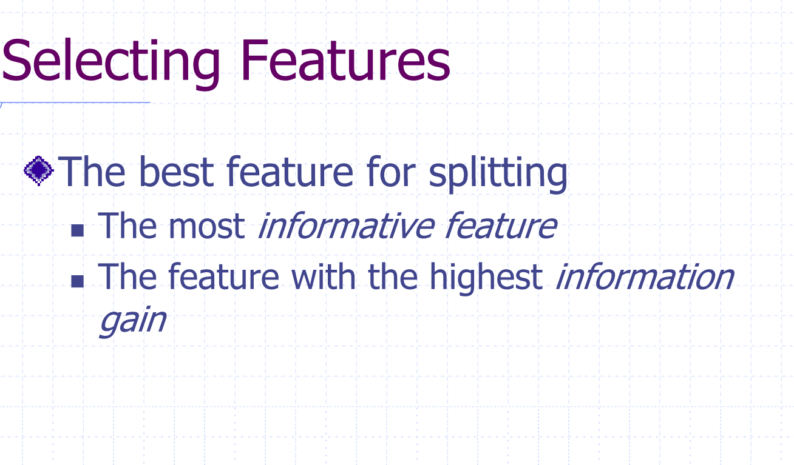

Slide 35
Using information theory
To implement Choose-Attribute in the DTL algorithm
For a training set containing p positive examples and n negative examples, the average amount of information contained in a correct answer is:

Slide 36
Information gain
A chosen attribute A divides the training set E into subsets E₁, … , E_{v} according to their values for A, where A has v distinct values.
Information Gain (IG) or reduction in entropy from the attribute test:
Choose the attribute with the largest IG

Slide 37
Information gain
For the training set, p = n = 6, I(6/12, 6/12) = 1 bit
Consider the attributes Patrons and Type (and others too):
Patrons has the highest IG of all attributes and so is chosen by the DTL algorithm as the root

Slide 38
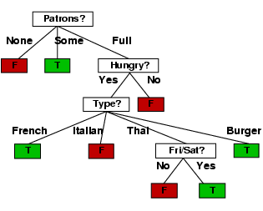
Example contd.
Decision tree learned from the 12 examples:
Substantially simpler than “true” tree---a more complex hypothesis isn’t justified by small amount of data

Slide 39
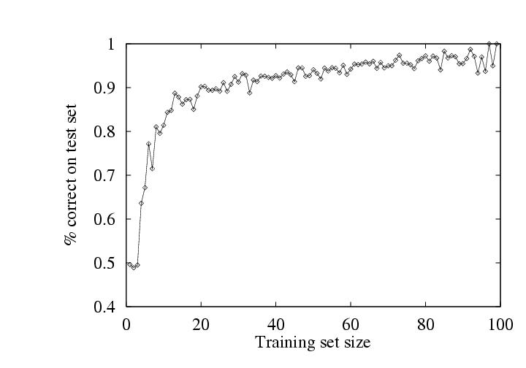
Performance measurement
How do we know that h ≈ f ?
Use theorems of computational/statistical learning theory
Try h on a new test set of examples
(use same distribution over example space as training set)
Learning curve = % correct on test set as a function of training set size

Slide 40
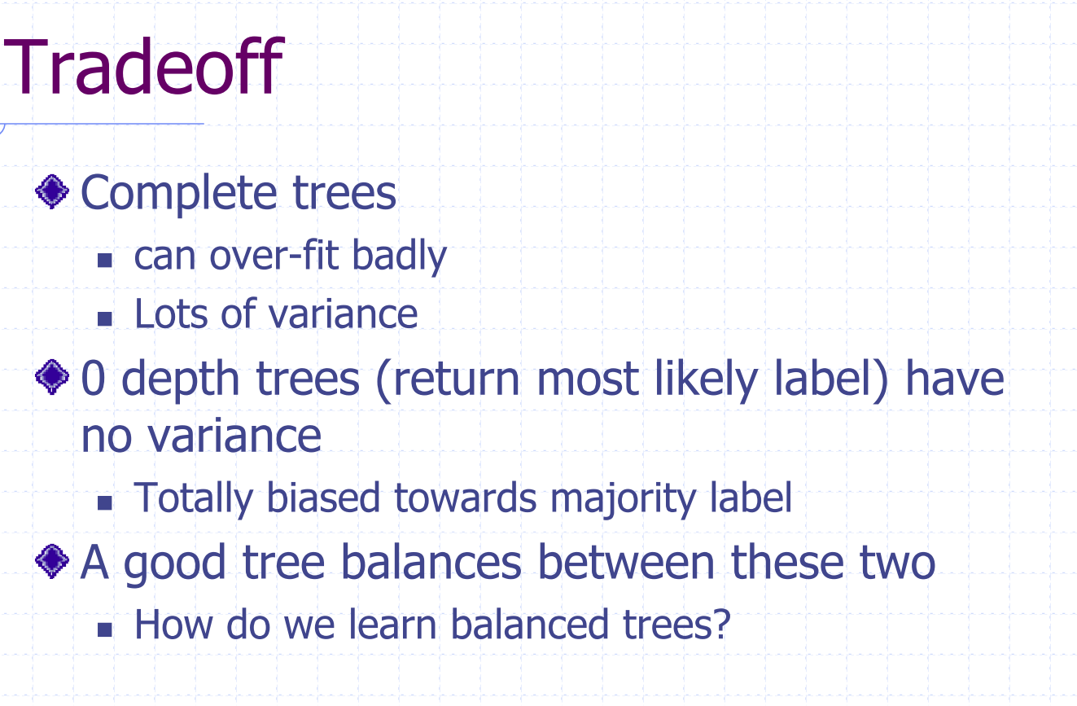

Slide 41
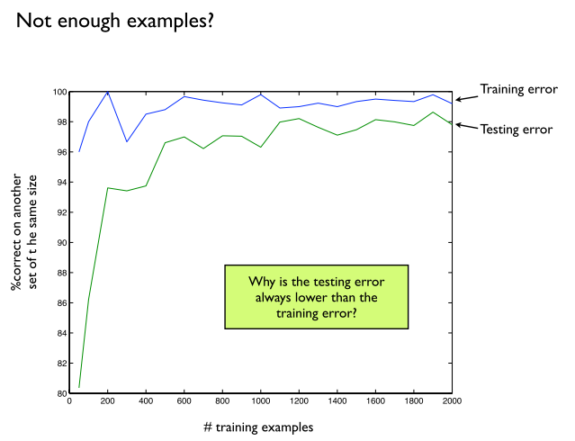

Slide 42
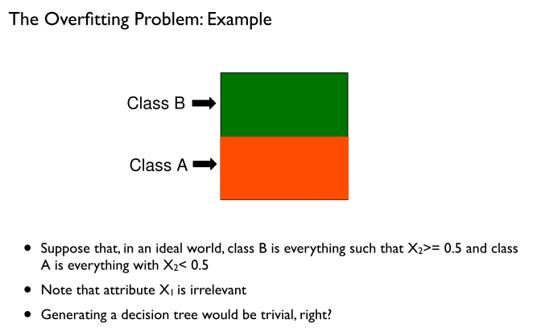

Slide 43
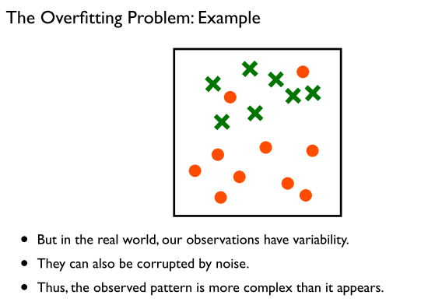

Slide 44
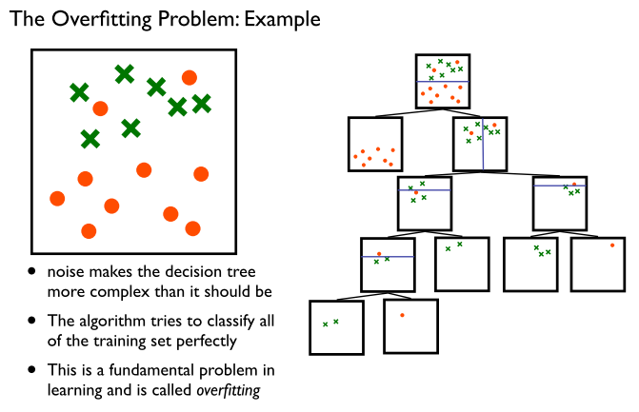

Slide 45
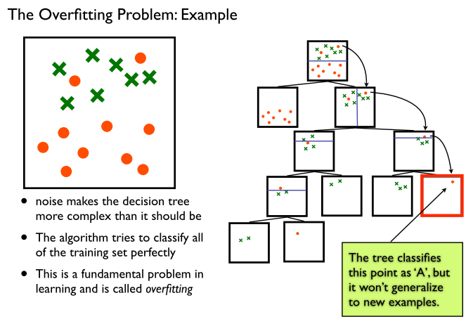

Slide 46
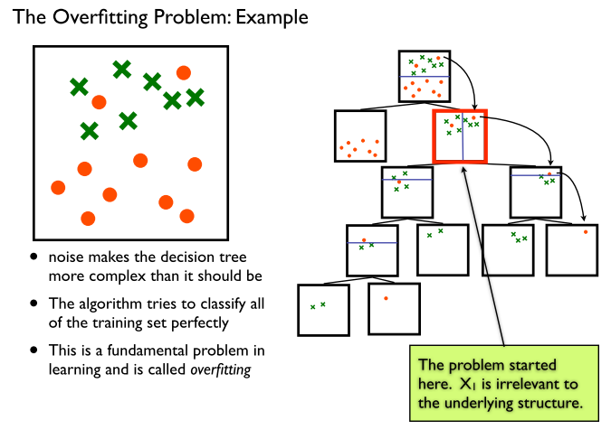

Slide 47
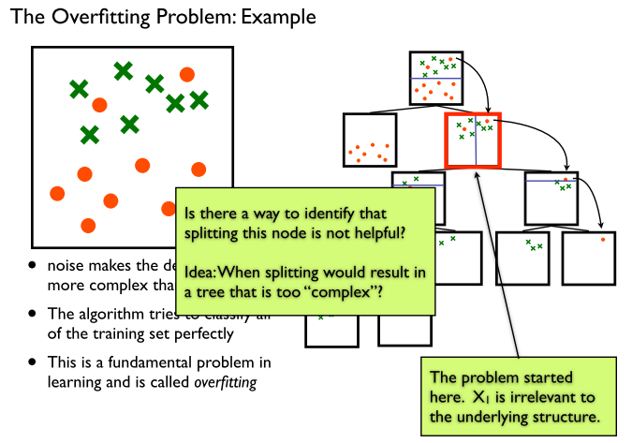

Slide 48
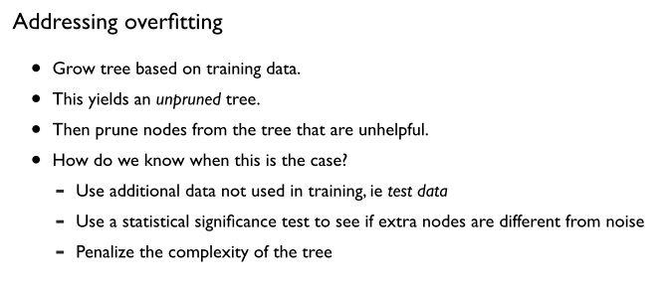

Slide 49
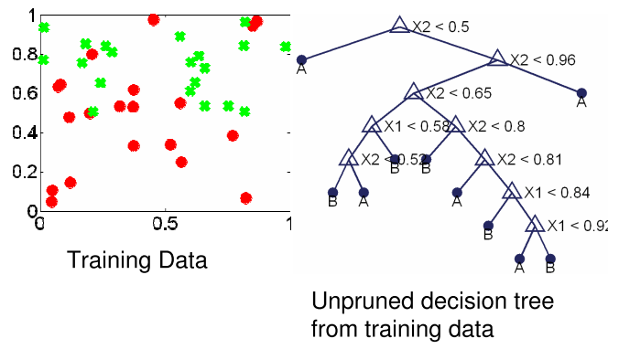

Slide 50
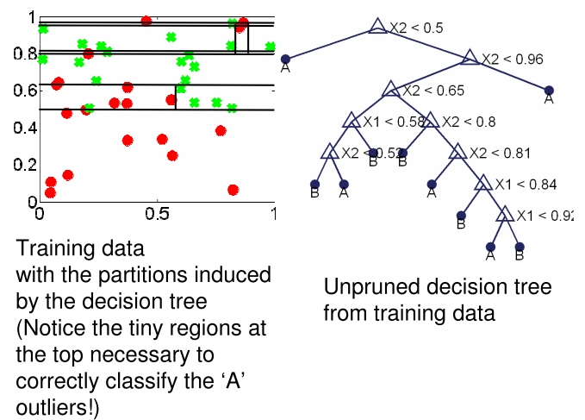

Slide 51
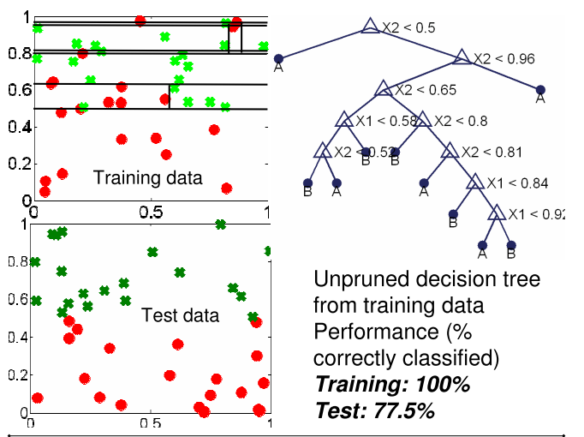

Slide 52
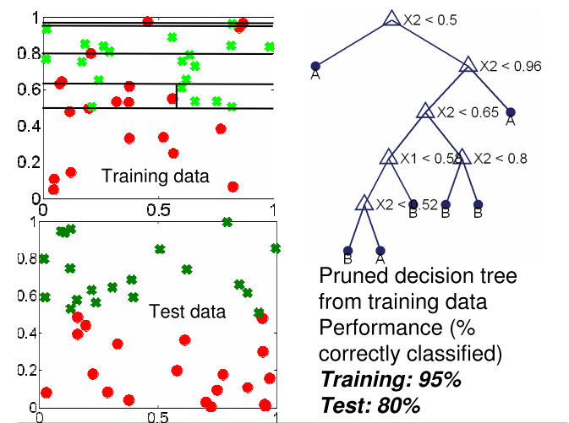

Slide 53
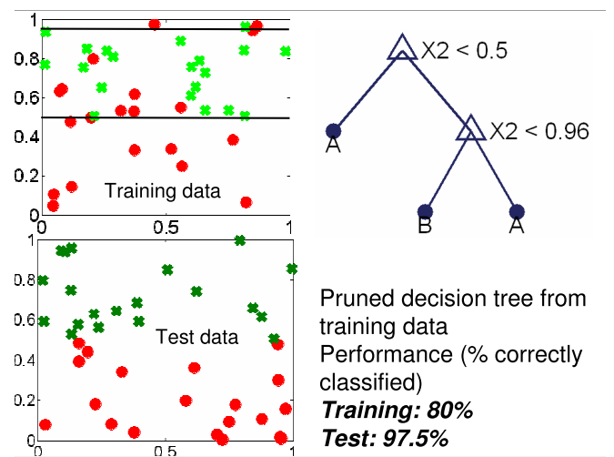

Slide 54
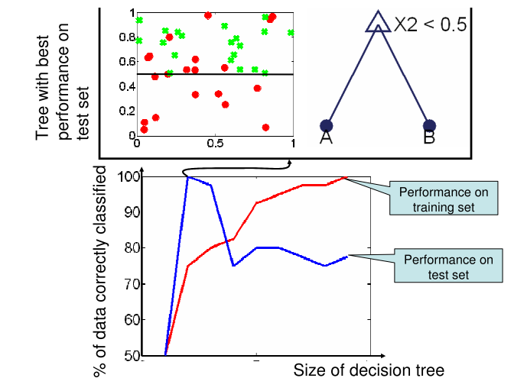

Slide 55
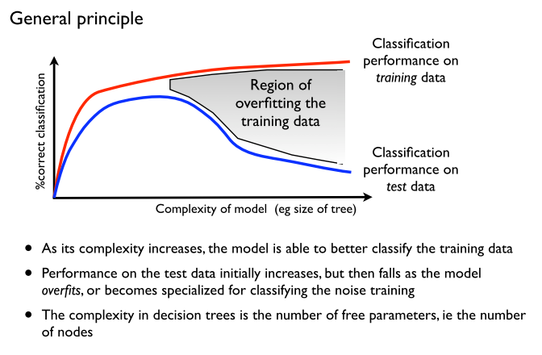

Slide 56
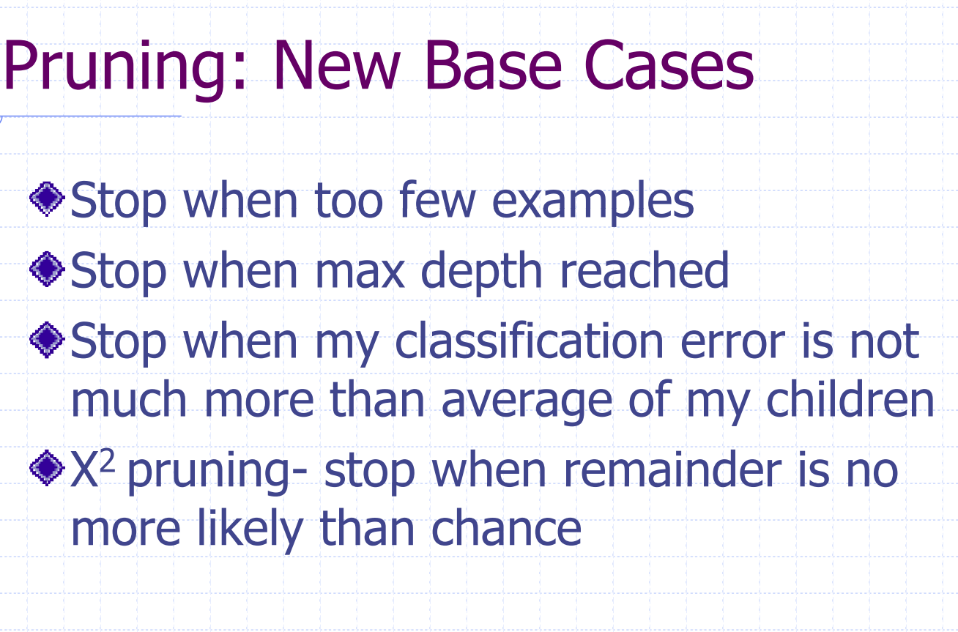

Slide 57
Extensions of the decision tree learning algorithm
Multi-value attributes: Use gain ratios
Real-valued data: Use split points
Noisy data and overfitting: Use pruning
Generation of rules
C4.5 is an extension of ID3 that accounts for unavailable values, continuous attribute value ranges, pruning of decision trees, rule derivation, and so on

Slide 58
Summary
Learning needed for unknown environments, lazy designers
Learning agent = performance element + learning element
For supervised learning, the aim is to find a simple hypothesis approximately consistent with training examples
Decision tree learning using information gain
Learning performance = prediction accuracy measured on test set

